Slide 1
Project Presentation of CO-OP Project at Industry (Module-2) (22CS421)
On
Agentic AI–Driven Intelligent RPA Task Orchestrator for Automated Document Processing Rishabh Jain
2210990725
Supervised By
Dr. Swati Goel
Department of Computer Science and Engineering,
Chitkara University, Punjab

Slide 2
Introduction
Robotic Process Automation (RPA) is widely used to automate repetitive business tasks.
Traditional RPA systems depend on static workflows and predefined rules.
Such systems lack flexibility when dealing with dynamic and unstructured documents.
Organizations receive documents such as invoices, reports, and forms through emails in multiple formats.
Manual workflow selection and document classification reduce automation efficiency.
This project introduces an agentic decision layer above traditional RPA workflows.
The system dynamically analyzes documents and determines suitable processing actions automatically.
2

Slide 3
Problem Statement
Traditional RPA systems are rule-based and rigid.
Static workflows fail when document formats change.
Human intervention is required for:
Document classification
Workflow selection
Error handling
Enterprises process large numbers of email-based documents daily.
Existing automation systems cannot intelligently adapt to varying document structures.
There is a need for a flexible and intelligent orchestration mechanism.

Slide 4
Objectives of the Project
Automate document intake from emails.
Extract data from unstructured PDF documents using OCR.
Implement an intelligent agent-based decision layer. Dynamically determine document type and processing strategy.
Route documents automatically based on classification.
Maintain execution logs and traceability.
Build a modular and scalable automation framework.

Slide 5
Proposed Solution
The proposed system introduces an Agentic AI–Driven RPA Orchestrator capable of:
Monitoring email inboxes automatically.
Downloading and organizing document attachments.
Extracting text using OCR.
Performing intelligent document classification.
Dynamically controlling workflow execution.
Logging all operations for monitoring and auditability.
The system combines:
UiPath RPA workflows
Python-based agent logic
OCR-based document preprocessing

Slide 6
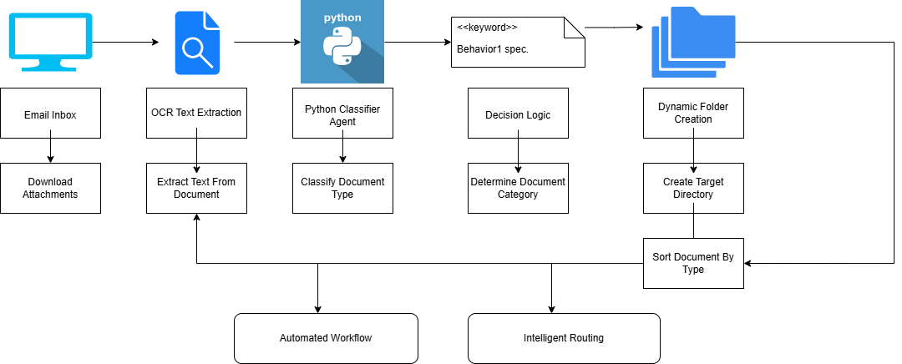
System Architecture

Slide 7
Workflow Explanation
Step 1 — Email Monitoring
Outlook inbox is continuously monitored.
Unread emails matching criteria are fetched.
Step 2 — Attachment Extraction
PDF attachments are downloaded automatically.
Files are stored in timestamp-based folders.
Step 3 — OCR Processing
OCR extracts text from PDF documents.
Raw text is converted into machine-readable format.
Step 4 — Agentic Decision Layer
Python-based classifier analyzes extracted text.
Document type is determined dynamically.
Step 5 — Dynamic Routing
Appropriate workflow actions are selected.
Documents are routed automatically.
Step 6 — Logging
Processing status and exceptions are logged.

Slide 8
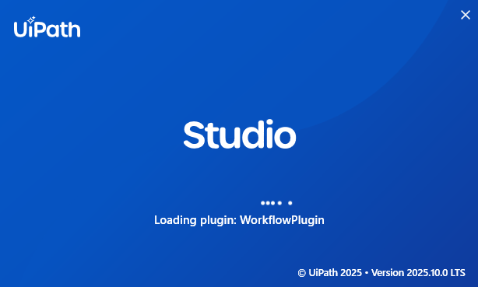

Technologies Used
Technology | Purpose
UiPath | RPA workflow automation
Python | Agentic document classification
Outlook Integration | Email monitoring
Microsoft OCR / Tesseract OCR | Text extraction
File System Routing | Dynamic document organization
TXT/JSON Communication | Data exchange

Slide 9
Results Achieved
Successfully Implemented:
Automated email-based document ingestion
PDF attachment extraction
OCR-based text extraction
Raw text generation
Dynamic document handling
Logging and exception handling
System Outputs:
OCR-generated text files
Execution logs
Organized document storage
System Characteristics:
Event-driven
Modular
Scalable
Fault tolerant

Slide 10
Future Scope
Support multiple document types
Add advanced AI/ML models
Integrate dashboards and analytics
Human-in-the-loop approval workflows
Cloud deployment Integration with enterprise ERP systems
Advanced confidence-based orchestration

Slide 11
Conclusion
The project successfully demonstrates an intelligent document processing framework.
An agentic decision layer is integrated with traditional RPA workflows.
The system automates:
Email monitoring
OCR processing
Document classification
Workflow routing
The architecture is modular, scalable, and extensible.
The project establishes a foundation for future intelligent enterprise automation systems.

Slide 12
Thank You
12

